Slide 1
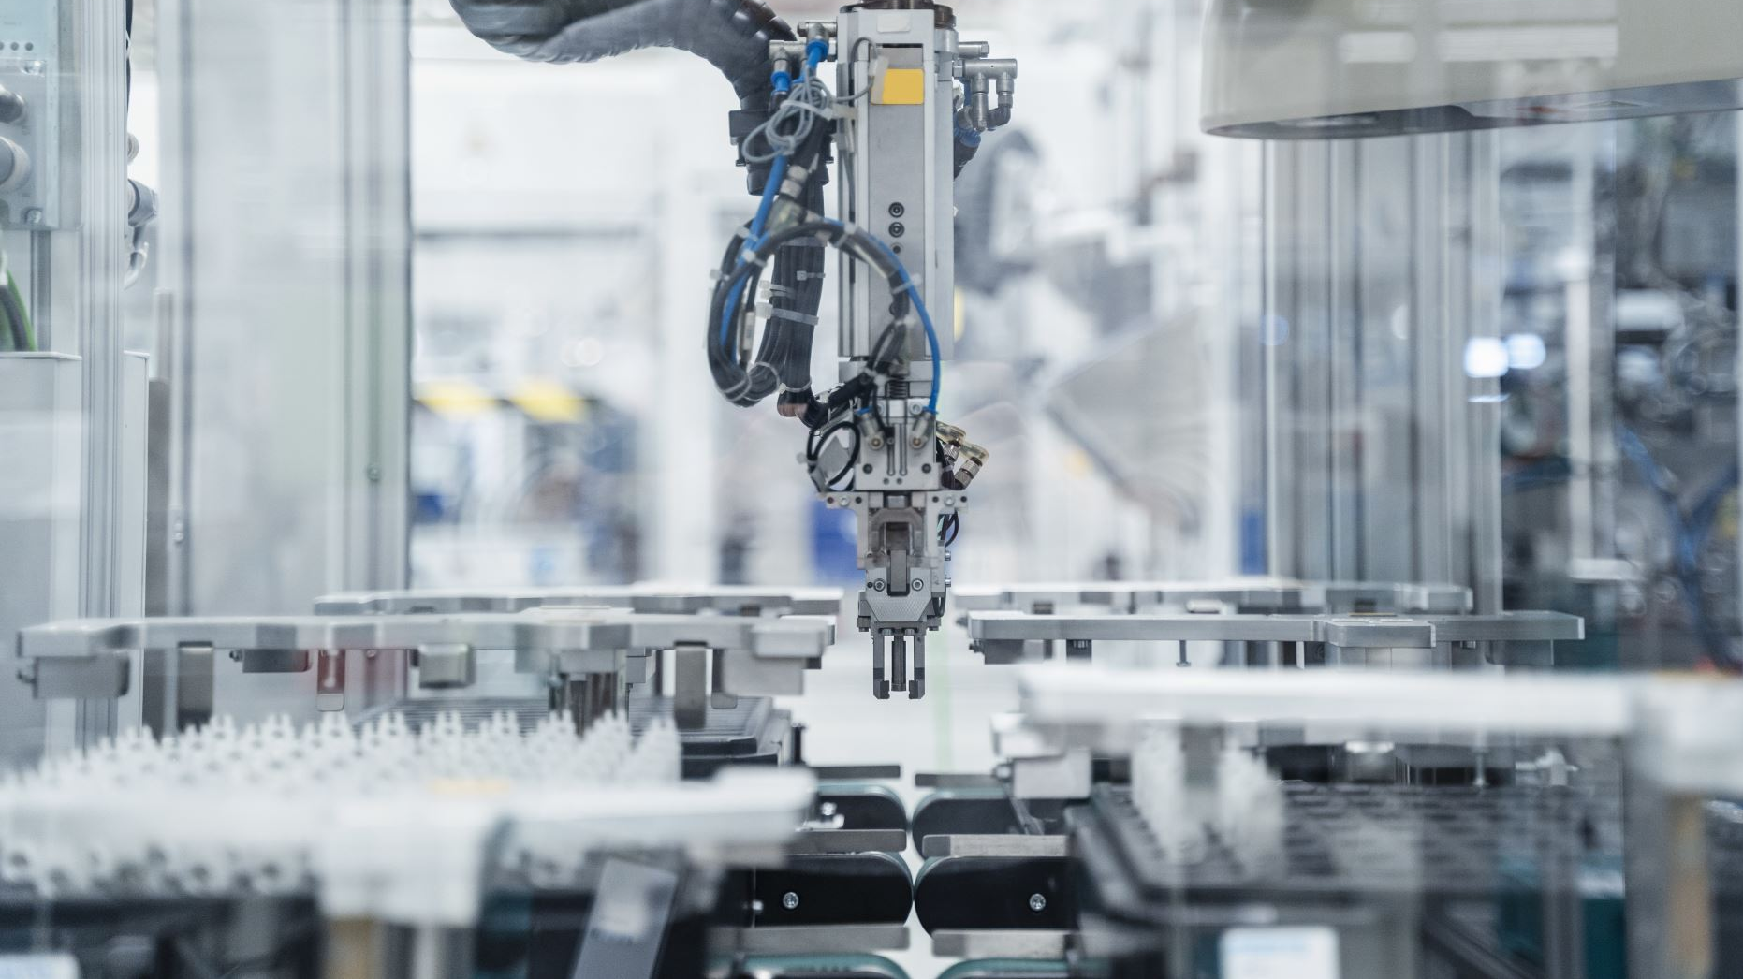
Robotic Process Automation (RPA) Opportunity for CA's
By
CA Parth Chauhan
(Engg.)

Slide 2
Introduction
Robotic process automation (RPA) is a form of business process automation that is based on software robots (bots) or artificial intelligence (AI) agents. It is sometimes referred to as software robotics (not to be confused with robot software).
There are varied human tasks that are repeated daily, which do not require intelligent working or processing such tasks can be automated using RPA.
Ex. Opening a browser, going to a stock market website such as BSE/NSE and getting stock data. Such a task can be automated using RPA.

Slide 3
What is RPA ?
Robotic : The word “Robotic” may sound like a physically shaped strong and bulky BOT but it is all about software, with no physical shape or form. Like any other software “Robotic” also supports human efforts by automating human activities in an enterprise. It is sometimes referred to as software robotics.
Process : Word “Process” can also be misnomer, a better alternative would be “task”, which is what RPA aims to automate. A combination of such “tasks” adds up to a process.

Slide 4
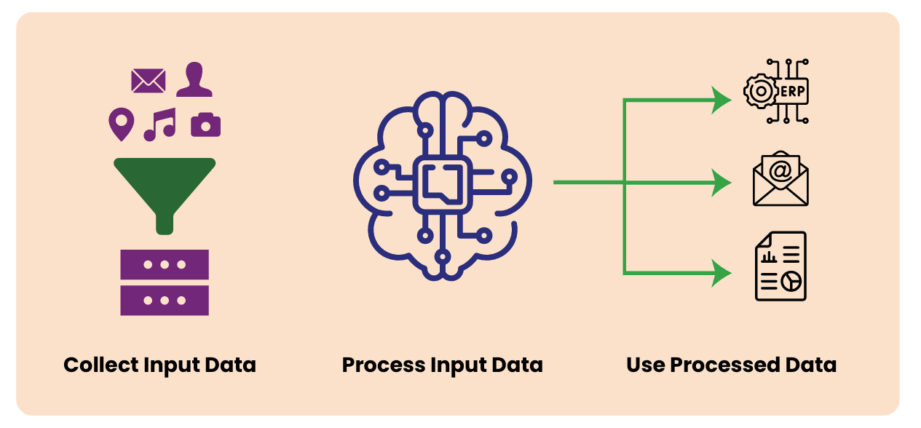
RPA can be better understood as a Digital Worker trained to tasks performed by humans with no or minimal value. It primarily performs below functions (Refer to Figure 1 below) :

Slide 5
Collection of Inputs: RPA can be trained to collect data as input from any digital source.
Processing of raw data collected: RPA has a strong processing engine, coupled with Artificial Intelligence and Machine Learning, it can process volumes of data with unmatched speed and without any errors.
Entering/ Presenting/ publishing the data in the Target application: RPA can use the processed data for variety of ways including:

Slide 6
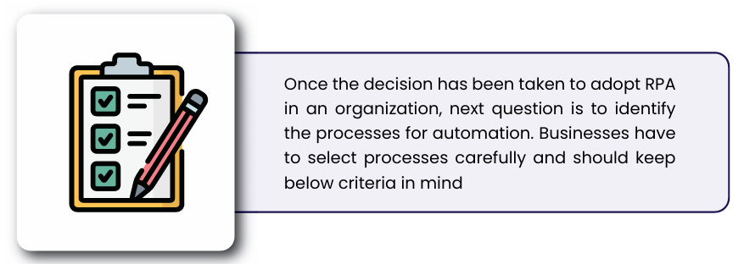
Key Concepts
HOW DOES RPA WORK?
WHERE DOES RPA WORK?
Notes:
HOW DOES RPA WORK? RPA mirrors the way humans carry out their tasks. RPA is sort of “Record and Playback”. The simplest RPA BOT can be created by recording clicks and keystrokes of the Users when they interact with applications. RPA can then schedule all such tasks sequentially to automate a complete process. There are various tools and technology available for RPA to automate business processes. These tools/ technology can be effectively used to automate mundane repetitive tasks. The technology to be selected depends on the complexity of the tasks to be automated.
WHERE DOES RPA WORK?
Rules-driven: Processes that are rules-based and consistent are good candidates. Repetitive in Nature: Manual and repetitive tasks are the right processes. Data Intensive: Tasks that involve systematic churning of voluminous data. Electronic Trigger: Processes that commence on receiving electronic data files. High error rates: Tasks that involve paper-based data entry or are interdependent. Manual Calculations: Laborious tasks involving manual calculation of results, where one error leads to another. Out-of-Hours jobs: Seasonal work overloads, round-the-clock tasks, which involve resolving complaints, orders, etc. Electronic Start/End points: Processes involving digital inputs/outputs with intermittent manual steps. High Compliance: Processes that require audit proofs for regulatory compliance. Validations: Tasks involving multiple systems where validations are required at each synapse. Huge number of resources: Tasks involving many resources and multi-step processes

Slide 7
Web Scraping
What is Web Scraping?
Definition: Web scraping is the process of extracting data from websites.
Uses: Data collection for analysis, competitive pricing, research, etc.

Slide 8
How Does Web Scraping Work?
Explanation: Accessing web pages using a scraper tool, parsing the HTML, and extracting the required data.

Slide 9
Tools and Libraries for Web Scraping
Python Libraries: BeautifulSoup, Scrapy, Selenium
Power Automate
Power UI

Slide 10
Case Studies
SIMPLE RPA using selenium

Slide 11
GST Site Automation using RPA
Code :
import time
from selenium import webdriver
from selenium.webdriver.common.by import By
from selenium.webdriver.chrome.options import Options
chrome_options = Options()
get_site = "https://services.gst.gov.in/services/searchtp"
# We set the driver Path
chromedriver_path='D:\seleniumDriver\chromeSpecial.exe'
# We set the special chrome for working
chrome_options.binary_location="D:\seleniumDriver\chrome\chrome.exe"
# Let's make a driver to start the application
driver = webdriver.Chrome(options=chrome_options) # service=service,

Slide 12
# Open the website
driver.get(get_site)
# GST No for testing :
gst_no = "27AAECM1259J1ZC"
# GST Site GST No element
gst_no_ele = driver.find_element(By.ID,"for_gstin")
# Put our GST No
gst_no_ele.send_keys(gst_no)
# Get Captcha No from User Input
captcha = input("Please input Captcha :")
# Let's get captcha element :
captcha_ele = driver.find_element(By.ID, "fo-captcha")
# Let's input captcha
captcha_ele.send_keys(captcha)
# Let's press submit button
submit_ele= driver.find_element(By.ID, "lotsearch")
submit_ele.click()

Slide 13
# Put some time delay for the page to be loaded
time.sleep(5)
# Get all data
gst_data = driver.find_element(By.ID, "lottable")
print(gst_data.text)
# close the browser
driver.quit()

Slide 14
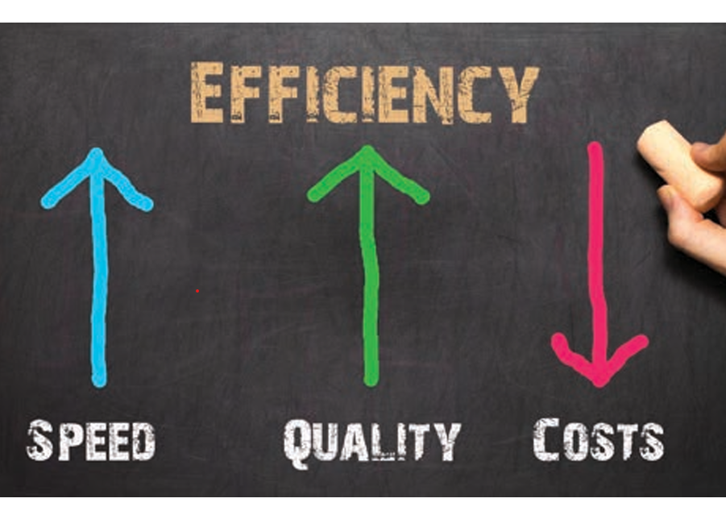
Benefits of RPA in Accounting:
Efficiency: RPA streamlines tasks like data collection, risk management, and accounts payable/receivable.
Enhanced Employee Abilities: By automating complex work, RPA allows employees to focus on value-added tasks.
Error Identification: While RPA processes may have minor errors, they can be rectified, ensuring data accuracy.

Slide 15
Advantages of RPA in Chartered Accountancy
Time-saving by bringing in efficiency
Maximum accuracy
Improves productivity
Better delivery to our clients

Slide 16
THE FUTURE OF ROBOTIC PROCESS AUTOMATION
There is a fast adoption of RPA in several organizations globally, less than one-third of adopters use the technology in accounting and financial reporting. The RPA application is growing in popularity across all business functions. If the business adopted the RPA, one can expect RPA to be adopted in other departments – and soon.
Like the machine revolution resulted in increased productivity from humans even RPA though threatening initially will result in increased productivity and humans doing more creative and interesting work rather than repeated mundane daily tasks.

Slide 17
Conclusion
Robotic Process Automation (RPA) in Accounting:
Shifts the role of finance from tactical and transactional to more strategic.
Provides accounting professionals with increased time and visibility into business performance.
Enables continuous improvement.
Helps organizations address process problems through frequent reviews.
Ensures consistency in execution.
Allows straightforward adjustments to overall processes.
Frees individuals from mundane tasks, allowing them to focus on value-added work.
Empowers finance executives to play a strategic role by leveraging timely and insightful details.
In summary, RPA transforms accounting by enhancing efficiency, freeing up time, and enabling strategic decision-making.

Slide 18
Thank you

